Slide 1
VA Career Works EST Meeting

Slide 2
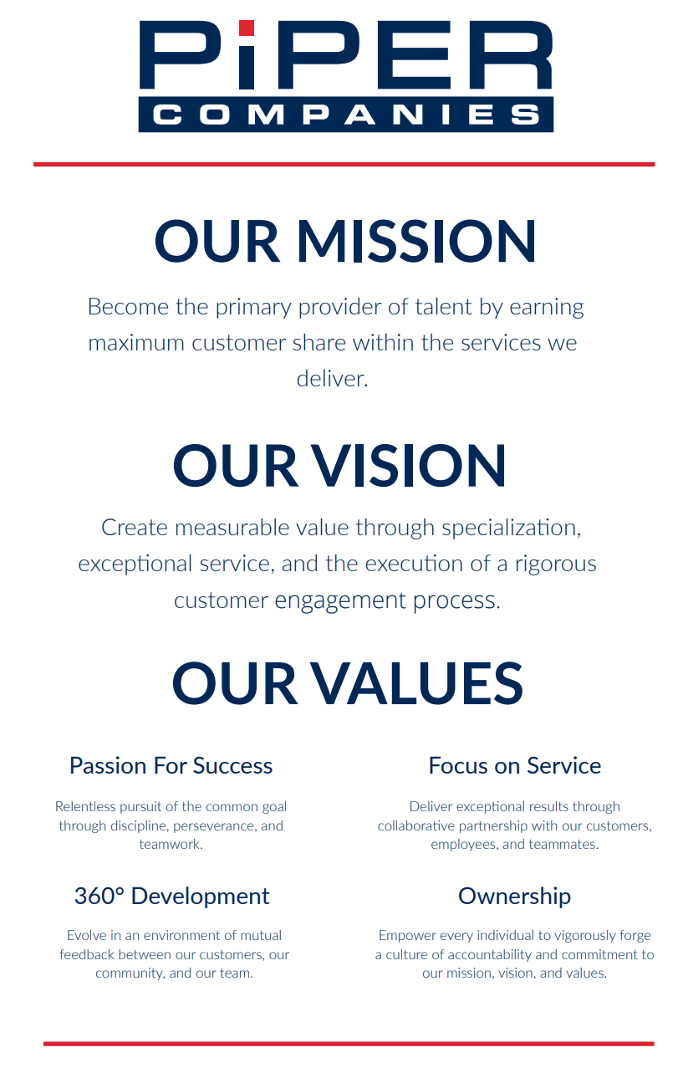
Company Structure & Values

Slide 3
Piper Companies

Slide 4
Company Overview
Piper is an elite staffing agency and human capital solutions firm specializing in information technology, life sciences, and clinical solutions
Industries Served:
IT Infrastructure & Cloud
Since company inception in 2011, we have been committed to developing collaborative partnerships with the clients and consultants we serve. It is at the core of our business to support our clients in building high performing teams, while connecting premier talent with exceptional opportunities. We augment our solutions with a unique program management methodology that allows us to deliver measurable results and a predictable hiring experience for both clients and candidates. Our services extend nationwide with physical office locations in Mclean, VA; Raleigh, NC; Columbia, MD; Conshohocken, PA.
Software Development
Business Intelligence & Data Analytics
Information Security
Clinical Research & Life Sciences
Applied Health

Slide 5
Company Verticals
Software Development
Information Security
IT Infrastructure
Business Analytics
Biostatistics
Clinical Operations
Data Management
Regulatory Affairs
Research & Analytical Development
Technical Operations
Process Development & Manufacturing
Quality & Regulatory Compliance

Slide 6
Services Provided
Piper Companies provides customers with three candidate onboarding solutions:
Management & Talent Acquisition Consulting
Direct Placement
Staff Augmentation
With a focus on understanding our clients’ culture, vision, and technical requirements, our tenured recruiting team works to grow the permanent employee base in ways that will assure the creation of long-term value for the organization.
Piper specializes in helping organizations meet project staffing goals by delivering talent and resources on a contract and contract-to-hire basis. When the need is sudden and critical, we are able to onboard the right people in rapid fashion.
Our experts help clients balance their objectives, manage risks, and overcome constraints to successfully complete project milestones, key performance indicators, scope of work deliverables, and business objectives on-time and within budget.

Slide 7
Partnering With Piper
We Believe in Partnerships
As a client, we will be your true business partner. Each client relationship is grounded in our Piper Engagement Process, which delivers measurable results and a predictable hiring experience for both clients and candidates.
Taking the time to
understand your business
Staying connected
throughout the engagement
Not just encouraging feedback,
but actually employing it
Applying the same
approach to candidates
Managing expectations
all around

Slide 8
Zachary Piper Solutions

Slide 9
Company Overview
Zachary Piper Solutions
Zachary Piper Solutions is a United States Government contractor delivering human capital solutions in support of the Intelligence Community, Homeland Security, State Department, Department of Defense and various Civilian Agencies.
Solutions:
Cyber Systems & Solutions
Mission IT
Data Analytics
Intelligence Analysis & Operations
Mission Systems
Engineered Solutions
Capabilities:
Software Development & Engineering
Systems Engineering
IT Architecture
All Source Analysis
Intelligence Analysis
Enterprise Data Systems
Mobile Platform Development
ZPS is a Top Secret Cleared Facility providing talent within Software Development, Systems & Network Engineering, Cloud, Data Storage, Virtualization, Intelligence, and Cyber Security.
© 2019 Zachary Piper Solutions, a ZP Group Company- All Rights Reserved

Slide 10
Industry Past Performance
Zachary Piper Solutions
Zachary Piper Provides Comprehensive National Security related technology services. We are a subcontractor to multiple Intel, Defense and Civil programs. We specialize in the following areas:
Cyber Intelligence, Systems and Operations
Geospatial
Information Technology
Software Engineering
Intrusion Detection and Analysis
Information Assurance
Forensics
Malware Analysis
Reverse Engineering
Open Source Collection & Exploitation
SME;FMV, LIDAR, WAMI
PED
Database Development
Software Development
Systems Engineering
Networking Engineering
GOTS / COTS Deployment
Security Architecture
Security Engineering
O&M
Java / .NET / C++
Map reduce
Hadoop
Mass Analytics
BOT Development
© 2019 Zachary Piper Solutions, a ZP Group Company- All Rights Reserved

Slide 11
Government Customers
Zachary Piper Solutions
© 2019 Zachary Piper Solutions, a ZP Group Company- All Rights Reserved

Slide 12
Industry Partners*
Zachary Piper Solutions
*Current Active or Former Sub to Prime Contract
© 2019 Zachary Piper Solutions, a ZP Group Company- All Rights Reserved

Slide 13
Questions?
Contact: Grace Czechowski
Email: gczechowski@pipercompanies.com
Phone: 716-672-9398

