Slide 1


Northern Virginia
Senior Community Services Employment Program (SCSEP)

Slide 2
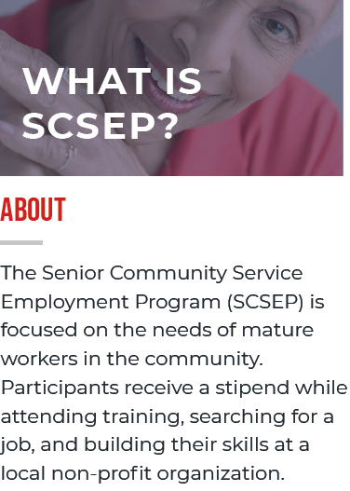
Northern Virginia Senior Community Service Employment Program (SCSEP)
SCSEP provides temporary community service training opportunities to older workers to prepare them for jobs outside of the program and help them remain healthy and secure.
Notes:
On July 1, 2019, the Virginia Senior Community Service Employment Program (SCSEP) under the National Council on Aging (NCOA) was sub-contracted to the SkillSource Group, Inc. in partnership with the Fairfax County Department of Family Services (DFS).

Slide 3
SCSEP Supportive Services
SCSEP provides participants with other training and support services that are important for finding future employment, including:
Individual Employment Plan (IEP) development
Specialized training to prepare for placements
Assistance in securing future employment
Access to Virginia Career Works Centers

Slide 4
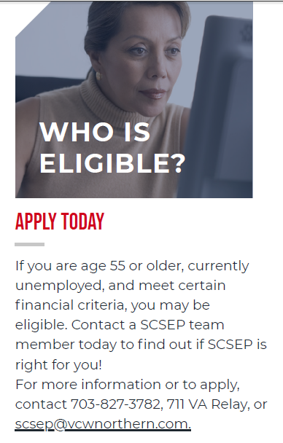

Slide 5
Grant Participation
All SCSEP participants must be:
  Aged 55+
  Unemployed
  Able to meet financial guidelines*
Participation limits:
  4-year work experience
  25 hours per week (fluctuates based on enrollments)
  Pay not to exceed minimum wage

Slide 6
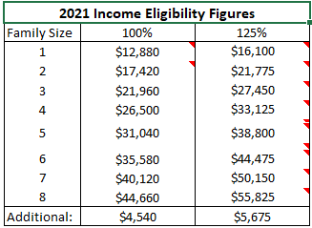
Income Eligibility Guidelines

Slide 7
Priority of Service
Priority of service is given to individuals who meet one or more of the following categories:
  Veterans and qualified spouses.
  Over the age of 65.
  Living with a disability.
  Low literacy skills or limited English proficiency.
  Reside in a rural area.
  Homeless or at risk of homelessness.
  Low employment prospects.
  Failed to find employment after using services through the American Job Center system.

Slide 8
Training Assignments
SCSEP offers a wide variety of temporary community service training positions at both nonprofit and public facilities, including:
These positions are designed to provide the skills and experience necessary to obtain future employment outside the program.
Additional training through lectures, seminars, one-on-one instruction and training programs.
  Hospitals
  Schools
  Senior Centers
  Government agencies
  Libraries
  Recovery Centers

Slide 9
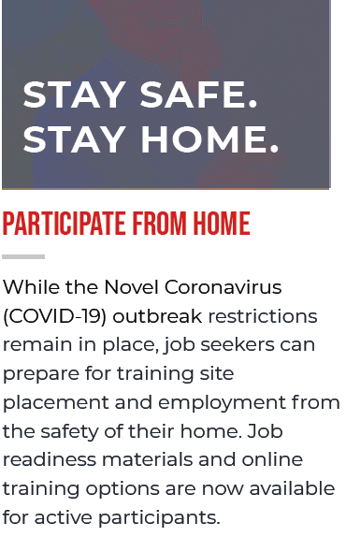
Training During the COVID-19 Pandemic
Virtual Training
  Webinars
  Job Readiness Booklet
  American Job Center (by appointment)

Slide 10
Community Service Training
On-site at Host Site Agency
  25hrs per week (subject to change)
  Monday through Friday
  8hr per day maximum

Slide 11
How to Enroll
Complete Enrollment Packet
Provide copy of ID, Passport/Social Security Card, supporting documents to verify your household income
Voided Check for Direct Deposit

Slide 12
Questions?
https://vcwnorthern.com/scsep/
dfsscsep@fairfaxcounty.gov

