Slide 1
Virginia Career Works Referral Portal
https://app.virginia.myjourney.com

Slide 2
The Virginia Career Works Portal was created to better connect Virginia residents to resources and increase dual enrollment
Redundancy
Efﬁciency
Transparency
Enrollment
Reduce duplicative paperwork required by different agencies
Increase service efﬁciency by sharing information among professionals serving the same residents
Generate data that allows state and local leaders to better allocate resources
By standardizing the referral recommendation process there is a decrease of bias and an increase in dual enrollment

Slide 3
Agencies collaborated to solve common intake process for workforce-related services

Slide 4
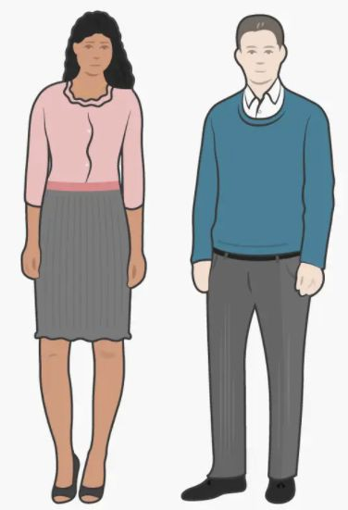
The Portal shields users from complex technology landscape, without replacing systems of record
Data ﬂow
Virginia residents
Virginia Career Works Referral
Portal
Create account
Setup user proﬁle
Receive, accept, and complete referrals to state beneﬁts and programs
Data trust
Legal, technical, and governance framework
Develops, manages, and sustains a collective of organizations data collaboration needs
NIST 800-53
security standards
Multiple, fragmented systems of record
Fully connected Partially connected
AWARE
(Title 4)
GeoSols (Title 1 & 3)
Virginia Workforce Professionals
Virginia Career Works Dashboards
View individual resident progress
View reports across groups of residents
VaCMS (TANF/SNAP)

Slide 5
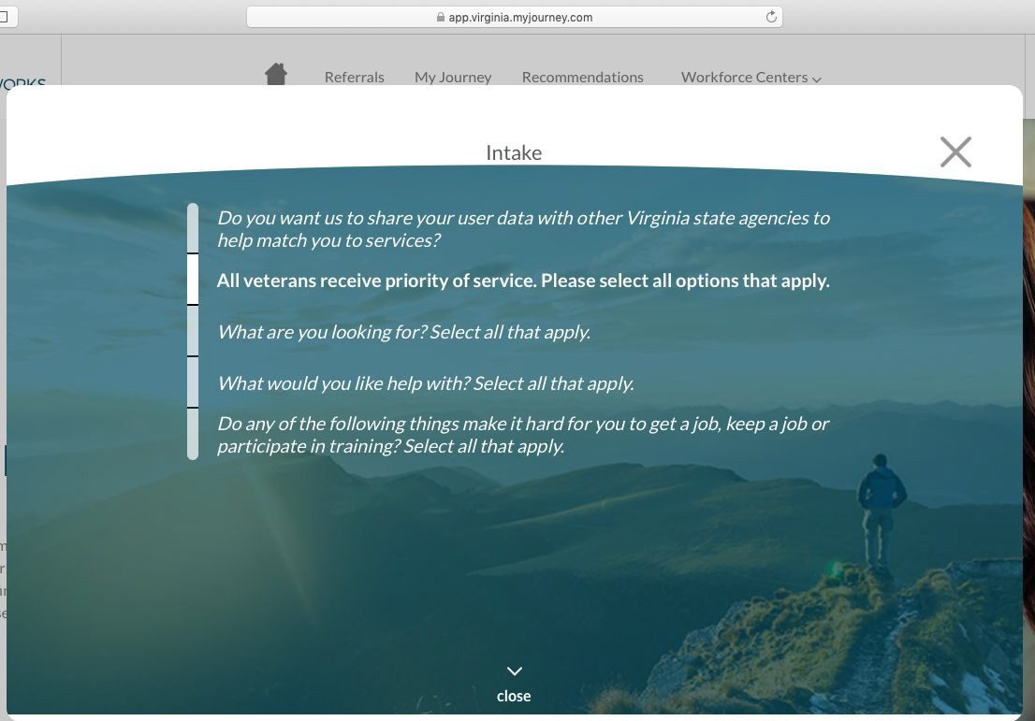
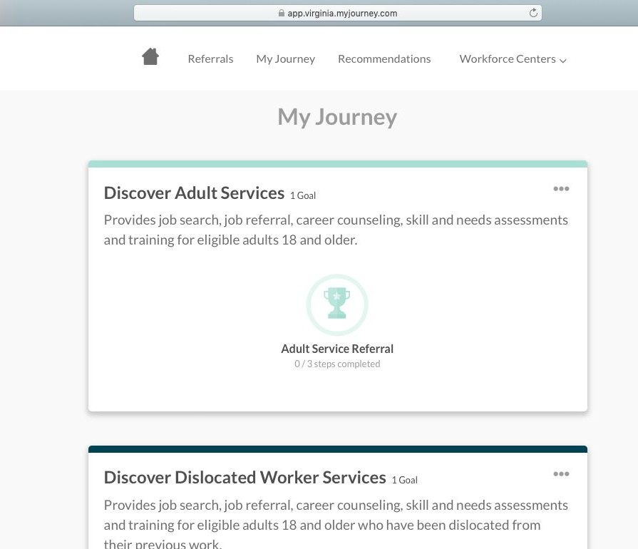
The Portal allows clients to independently complete the intake process and explore possible referrals prior to meeting with a workforce professional
1 2 3
User proﬁle setup
Recommended Referrals
Eligibility systems
○ Captures user information and
personalize recommendations
Captures clients information and barriers to personalize recommendations
Guides client step by step to different agency resources
Clients information is sent to eligibility systems

Slide 6
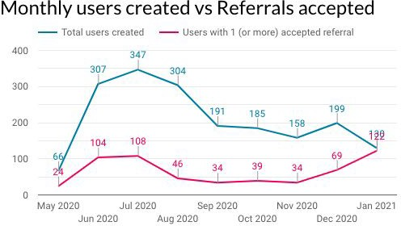
Top 4 Regions (including their WFCs)
User count
Northern VA
Cherokee Avenue Center (8)
Fairfax SkillSource Ctr-Alexandria (21)
Fairfax SkillSource Ctr-Annandale (26)
Fairfax SkillSource Ctr-Reston (24)
Loudon Workforce Resource Center (21)
Prince William Workforce Ctr (41)
141
Hampton Roads
Opportunity Inc. One Stop Workforce Ctr. (108)
108
Capital Region Workforce Partnership
Resource Workforce Ctr - Eastern Henrico (96)
96
Alexandria/Arlington
Alexandria City Employment Ctr (40)
Arlington Employment Ctr (47)
87

Slide 7
Virginia Career Works Referral Portal
https://vcwnorthern.com/wp-content/uploads/Final-Statewide-Vers_FULL_HD.mp4

Slide 8
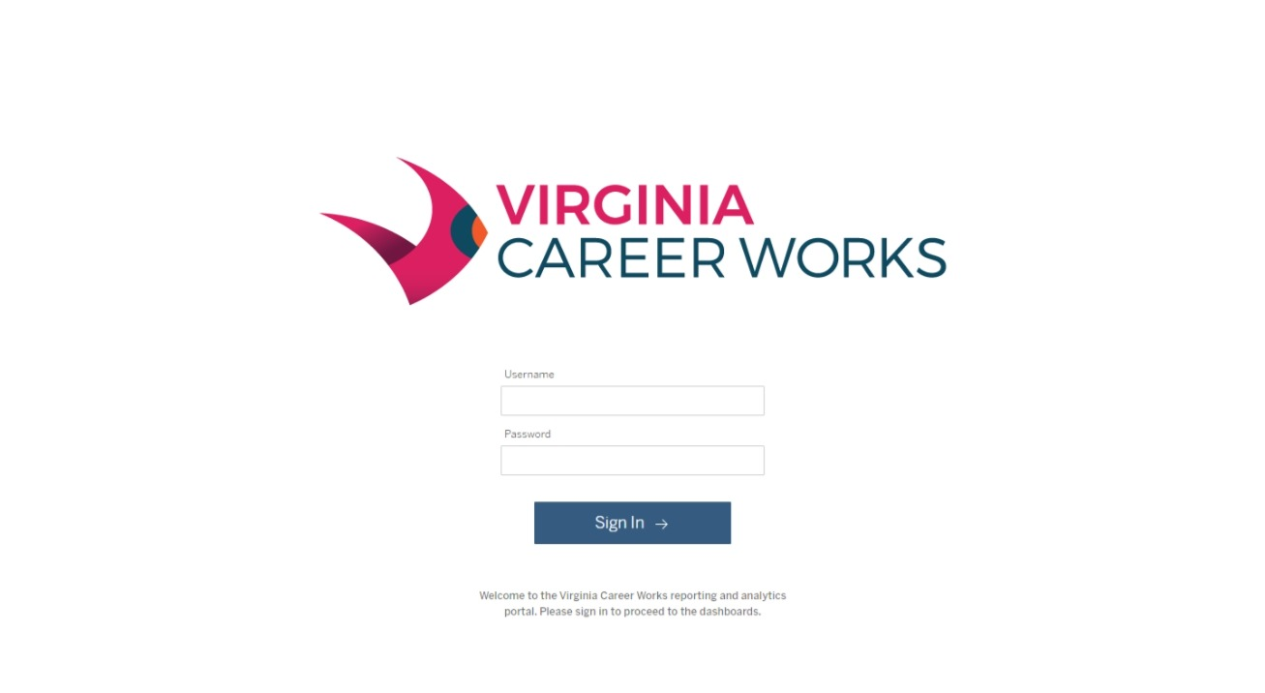

Slide 10
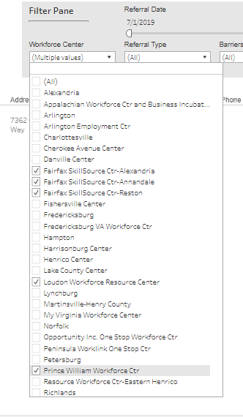

Slide 11
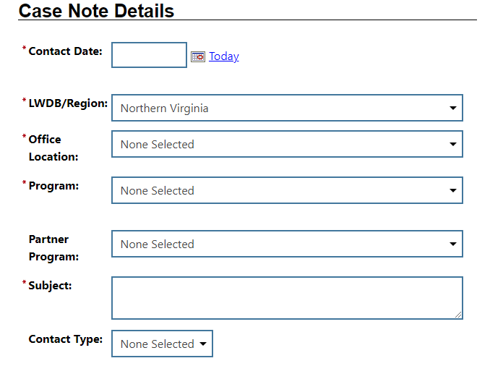

Slide 12
