Slide 1
Welcome to Amazon
Swati Dehnuwala- Staffing Coordinator
DMV Area

Slide 2




Why Amazon
Benefits
We also offer a full range
of benefits to regular, full-time U.S. employees that support them as individuals as well as eligible family members, including domestic partners
and their children.
Medical coverage*
401k investment
Time off options
Employee assistance
* Depends on role type

Slide 3




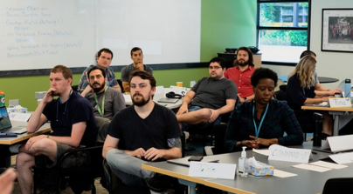

Why Amazon
Career choice
Career skills
Associate 2Tech
Advance your career
We strive to maintain an environment where people can learn, adapt, and excel. Amazon believes everyone should have the opportunity to learn new skills and build their career – whether that means at Amazon or elsewhere.
  The company pre-pays 95% of tuition and fees to earn certificates and associate degrees in high-demand occupations such as aircraft mechanics, computer-aided design, machine tool technologies, medical laboratory science, dental hygiene, solar technician, and nursing, to name a few.
Several programs that are designed to give the associates a way to move into a more highly-skilled career by providing the training and industry certification needed to make it happen.
This provides a huge opportunity for anyone who needs more technical skills to move into better paying roles.
Provides fulfillment center associates the opportunity to move into technical role , regardless of their previous IT experience, within Amazon’s vast operations network. This fully-paid for 90-day program is designed to place associates in on-the-job training for IT support technician roles and pays for their A+ Certification test, a widely- recognized certification.

Slide 4






Why Amazon
We protect our employees
Safety
CHECK TEMPERATURE
PRACTICE SOCIAL DISTANCING
PROVIDE MASKS
The health and safety of our employees and contractors around the world continues to be our top priority as we face the challenges associated with COVID-19. Leaders across Amazon
are meeting every day
to consider the evolving situation and are consulting with medical experts to ensure we are doing all
we can to keep our teams healthy.
PROVIDE GLOVES
CLEAN
DISINFECT

Slide 5
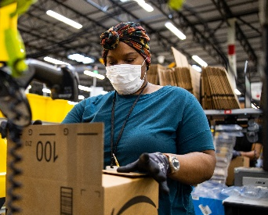
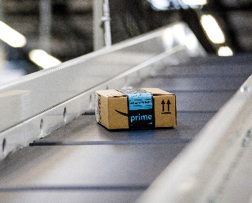
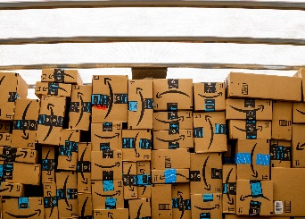
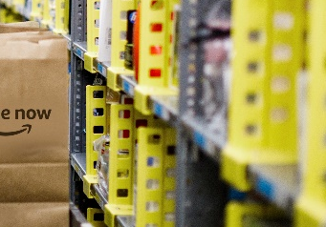
Our jobs
Fulfillment Centers
Sortation Centers
Work inside an Amazon warehouse, selecting, packing, and shipping customer orders.
You will interact with innovative technology daily.
Our sort centers are the first stop on the journey from the warehouse. You’ll be up on your feet moving and sorting packages between trucks.
Delivery Stations
Prime Now
Amazon’s delivery stations are the final stop before an order heads out for delivery to the customer’s door.
Enjoy the thrill of working with a small team to select and pack orders, and get items ready for delivery in an hour.

Slide 6
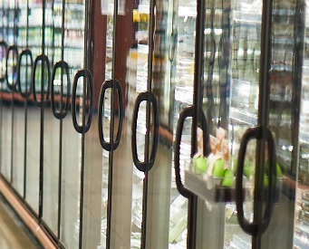

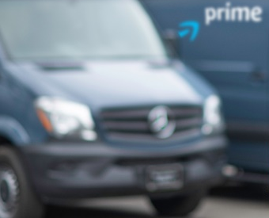
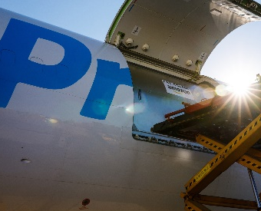
Our jobs
Fresh
Whole Foods Market
Make a customer’s day by gathering and packing orders for a perfect delivery. You’ll be provided with the right gear to work in a refrigerated area.
Get paid to shop. Shoppers choose flexible part-time schedules while earning industry-leading wages
working in Whole Foods.
Delivery Services
Amazon Air
Deliver packages to homes
and retail locations as a driver for an Amazon delivery service partner (DSP). No special license needed.
As an Amazon team member working at an Air Gateway/Hub, you will be handling the loading of cargo onto an aircraft from the warehouse.

Slide 7
Job Descriptions
Delivery Stations
Prime Now
Whole Foods Market
Amazon’s delivery stations are the final stop before
an order heads out for delivery to the customer’s door. . Part-time, and either overnight or early morning.
Shifts are four to six hours long, 15-25 hours each week.
Prime Now is Amazon’s super fast (2-hour or less) delivery service. Since orders may include fresh
and frozen items, it can be a cooler environment.
Select from flexible 3-4 hour shifts each week
Shoppers locate and carefully choose items in the comfort of Whole Foods and then package them for fast delivery of one or two hours. Select flexible hours each week—mostly mornings, evenings, and weekends—while earning industry-leading wages.
Sort, scan, and load customers orders to fulfill same
day and 2-day shipping delivery time
Part-time and flexible schedules
Shifts are four to six hours long, 15-25 hours each week.
Flex time: shift up or down by one hour
Assigned areas in the building change daily and during your shift
Just like being a personal shopper for our customer
Smaller than your typical warehouse
Flexible schedule - pick your own schedule weekly
2 or 4-hour shifts depending on the location
of a grocery store or retail location
Using an Amazon-provided device, Prime Now shoppers select items, message customers if replacement items are needed,
and pack the groceries for delivery
Shoppers only work in the store and do not deliver groceries
Work up to 20 hours a week or as little as four hours per month
* Depends on role type

Slide 8
1
2
JOB APPLICATION AND PREVIEW
ATTEND NEW HIRE APPOINTMENT
Hiring process
3
COMPLETE ONLINE NEW HIRE ORIENTATION
4
YOUR FIRST DAY!
PART-TIME SHIFTS
3-4 days/week and 4-5 hours/day
Typical Shift
Schedules
We offer both full-time and part-time opportunities that include morning, midday, late night and overnight shifts, and most of our buildings are open 365 days a year.
FULL-TIME SHIFTS
4-5 days/week and 8-12 hours/day
Full-time shifts usually include 1 weekend day
Ex: Sun – Wed, Wed – Sat
How do I select my schedule?
Pick your schedule for the week
Use the Amazon Moment App
Pick between 20-25 hours per week
What buildings offer flexible schedules?
Whole Foods
Prime Now
Amazon school accommodations
Amazon offers flexible part-time scheduling that allows students the opportunity to pick up shifts that work for them.

Slide 9












Affinity Network

Slide 10

Discover your next opportunity at Amazon
For Job Alerts
DCNOW1
TEXT
TO 77088
Apply Online
amazon.force.com

Slide 11
THANK YOU

